Slide 1



Exception Handling in Java
BY- Megha Kinikar

Slide 2
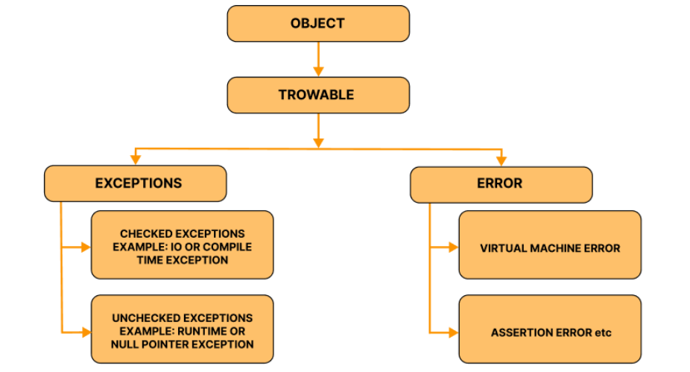
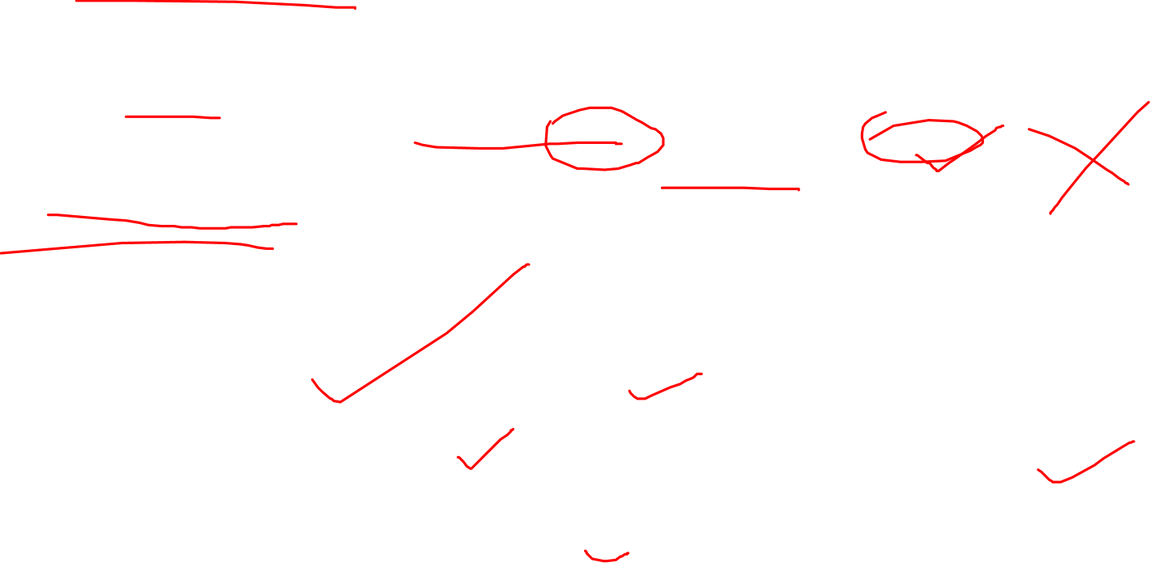
What is an Exception?
An exception is an event that disrupts the normal flow of a program's instructions. When an error
occurs within a method, the method creates an exception object and hands it off to the runtime
system. This object contains information about the error, including its type and the state of the
program when the error occurred.
The Java Exception Hierarchy
At the core of Java's exception handling is a class hierarchy. All exception and error types are
subclasses of the root class Throwable.

Slide 3

Checked vs. Unchecked Exceptions:
This distinction is crucial for Java developers.
1. Checked Exceptions
These are exceptions that are checked at compile-time. The compiler forces you to either handle them
or declare them in the method signature using the throws keyword. They typically represent scenarios
outside the program's immediate control.
Examples: IOException, SQLException, ClassNotFoundException.
public void readFile() throws IOException { // Declaring the exception
FileReader file = new FileReader("somefile.txt");
// This constructor can throw a FileNotFoundException (a subclass of IOException)
}

Slide 4
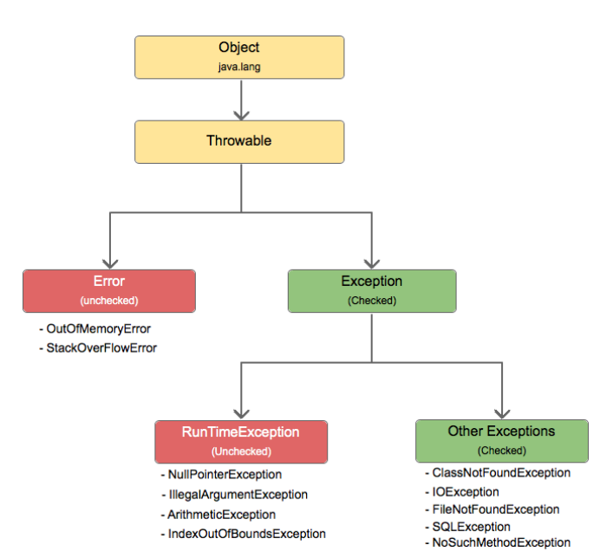

Unchecked Exceptions
These are exceptions that are not checked at compile-time. They are subclasses
of RuntimeException and usually indicate programming bugs, such as logic errors or improper use of
an API.
Examples: NullPointerException, ArrayIndexOutOfBoundsException, IllegalArgumentException.
public void divideNumbers(int a, int b) {
if (b == 0) {
throw new IllegalArgumentException("Divisor cannot be zero!");
}
int result = a / b;
}

Slide 5

The Building Blocks: try, catch, finally, throw, and throws
Java provides five keywords to manage the entire exception handling process.
1. The try Block
The try block contains a set of statements that might throw an exception. It must be followed by at
least one catch or finally block.
2. The catch Block
The catch block is used to "catch" and handle the exception thrown by the try block. You can have
multiple catch blocks for a single try.
try {
int[] numbers = {1, 2, 3};
System.out.println(numbers[5]); // This will throw an ArrayIndexOutOfBoundsException
} catch (ArrayIndexOutOfBoundsException e) {
System.err.println("Caught an array index error: " + e.getMessage());
} catch (Exception e) { // A more general catch-all
System.err.println("Caught a general exception: " + e.getMessage());
}

Slide 6
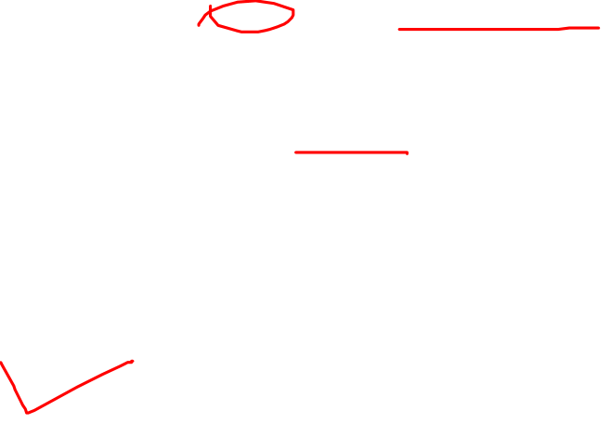
3. The finally Block
The finally block is optional and is used to execute important code regardless of whether an exception
occurred. It is the perfect place for cleanup activities, like closing files or database connections.
FileInputStream file = null;
try {
file = new FileInputStream("file.txt");
// ... read the file
} catch (IOException e) {
e.printStackTrace();
} finally {
if (file != null) {
try {
file.close(); // This will always run
} catch (IOException e) {
e.printStackTrace();
}
}
}

Slide 7


4. The throw Keyword
The throw keyword is used to explicitly throw an exception from your code.
public void setAge(int age) {
if (age < 0) {
throw new IllegalArgumentException("Age cannot be negative");
}
this.age = age;
}
5. The throws Keyword
The throws keyword is used in a method signature to declare that the method might throw the listed
types of exceptions, forcing the caller to handle them.
public void loadConfiguration() throws FileNotFoundException {
// This method might not find the config file
}

